Slide 1


Waste Segregation System
This presentation discusses the utilization of computer vision technology to automatically classify and separate recyclable, organic, and hazardous waste, enhancing waste management efficiency.

Slide 2

Introduction to Waste Segregation
Importance of Waste Segregation
Current Challenges
Role of Technology
Manual segregation is often ineffective and labor-intensive, leading to contamination of recyclables and increased waste disposal costs.
Leveraging technology like computer vision can streamline this process, leading to accurate and efficient waste classification.
Proper waste segregation is essential to reduce landfill waste and improve recycling rates, significantly benefiting the environment and public health.

Slide 3


Computer Vision Overview
1
Definition of Computer Vision
2
Image Recognition Techniques
3
Training Data
High-quality datasets are crucial for accurate model training and classification.
Enabling machines to interpret and make decisions based on visual data.
Algorithms like convolutional neural networks analyze images for waste identification.

Slide 4



Waste Classification Techniques
Organic Waste Detection
Algorithms can classify organic waste based on freshness cues and decomposition signs, facilitating composting processes.
2
Recyclable Materials
Computer vision can identify plastics, metals, and papers by recognizing shapes, textures, and colors to separate them effectively.
1
Hazardous Waste Identification
3
Techniques to detect hazardous waste involve identifying specific patterns or labels, ensuring safe handling and disposal.

Slide 5


Implementation of the System
Integration with Robotics
Real-Time Monitoring
User Interface
The system can provide live data on waste types and quantities, allowing for dynamic adjustments in waste management strategies.
A user-friendly interface could enable operators to supervise the sorting process and address anomalies efficiently.
Combining computer vision with robotics enhances the physical separation of waste, leading to automated sorting solutions.

Slide 6






Data Analysis and Graphs
85%
30%
40%
Segregation Accuracy
Processing Time Reduction
Increase in Recycling Rates
Graphs showcasing 85% accuracy in material segregation post-implementation.
Processing time reduced by 30% with the new automated solutions.
Recycling rates increased by 40% after implementing new systems.
25%
50%
Cost Savings
Landfill Waste Reduction
Cost savings of 25% compared to traditional segregation methods.
50% reduction in landfill waste supporting sustainability goals.

Slide 7

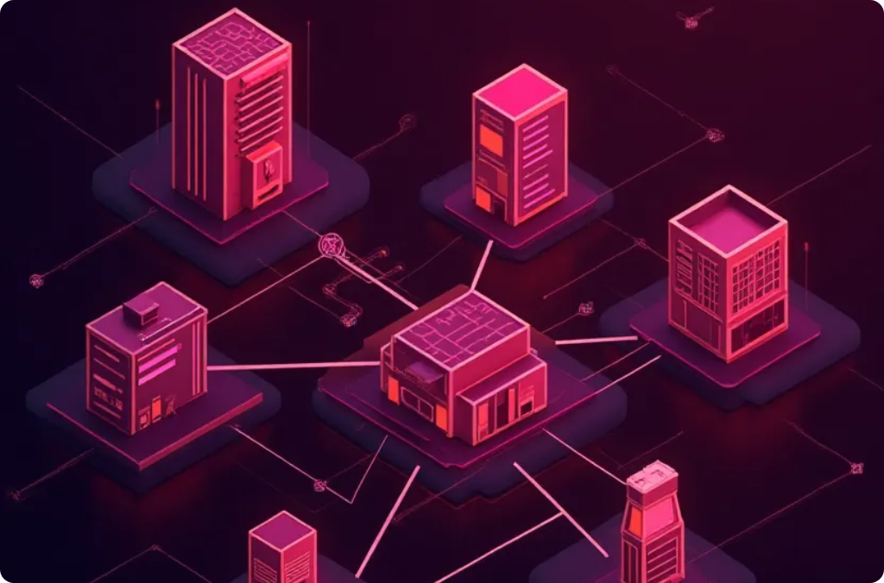

Future Scope of Computer Vision in Waste Management
Advanced AI Algorithms
Integration with IoT
Global Application
Future developments may lead to smarter AI models capable of evolving with new waste types and patterns.
Combining computer vision with Internet of Things (IoT) devices could enhance waste tracking and management across multiple sites.
The technology can be adapted globally, benefiting both developed and developing regions by improving waste management infrastructure.

Slide 8



Case Studies in Waste Management
Comparative Studies
2
Analysis of waste management before and after computer vision implementation.
Successful Deployments
1
Examples of cities or organizations integrating computer vision into waste management.
Global Initiatives
Overview of international programs using technology for better waste management practices.
3

Slide 9



Challenges and Solutions in Waste Management Technology
Data Privacy Concerns
Technical Limitations
Community Acceptance
Ensuring compliance with data protection regulations when capturing images in public spaces.
Addressing potential issues in image processing accuracy under varying environmental conditions, like poor lighting.
Engaging communities and stakeholders through awareness campaigns to foster acceptance of technology in waste management.

Slide 10




Conclusion
Collective Effort Required
Achieving success requires collaboration between technology developers, waste management companies, and regulatory bodies.
Significance of Computer Vision
Call to Action
This technology presents a significant opportunity to revolutionize waste segregation and management practices.
Encouragement for investment in and development of smarter waste segregation systems to create a sustainable future.
2
1
3

Slide 11




Q&A Session
Feedback and Suggestions
2
Invite suggestions from attendees about potential improvements or considerations for future projects in waste management.
Discussion Points
Open the floor for questions regarding the implementation, technology used, and potential hurdles in the waste segregation process.
1
Networking Opportunity
Encourage connection among participants interested in waste management solutions and technology collaborations.
3

